Slide 1

A Project Review Meeting on Doctor Appointment Booking System
By
ABHIDEV - 2520030325
DHARANI DHAR - 2520030163
Team Number: 21
Under the guidance of
Dr. NIRMALA JYOTHI
Associate Professor
Department of Computer Science and Engineering
Koneru Lakshmaiah Education Foundation (Deemed to be University estd. u/s. 3 of the UGC Act, 1956) Off-Campus: Bachupally-Gandimaisamma Road, Bowrampet, Hyderabad, Telangana - 500 043. Phone No: 7815926816, www.klh.edu.in

Slide 2
Outline of the Presentation
Abstract
Introduction
Problem Statement
Project Flow Diagram
Objectives with Justification
Modules[Frontend web pages]
Expected Outcomes of the Proposed Work
Conclusion
References

Slide 3
Abstract
The Doctor Appointment Booking System is a web-based healthcare application designed to simplify and digitize the process of scheduling medical appointments. In traditional healthcare systems, booking appointments often involves manual procedures, long waiting times, and difficulty in checking doctor availability. This project aims to overcome these challenges by providing an efficient, user-friendly, and centralized online platform for appointment management.
The system allows patients to search doctors based on specialization, location, and availability. Users can view doctor profiles, select preferred appointment dates using an interactive calendar, choose available time slots, and confirm bookings instantly. The application also provides facilities such as appointment reminders, booking history, cancellation, rescheduling, and patient profile management for better convenience and accessibility.
An administrative panel is provided to manage doctor profiles, schedules, patient appointments, and booking records efficiently. Administrators can add new doctors, update availability slots, monitor appointments, and manage overall system operations. This helps improve hospital workflow, reduce scheduling conflicts, and enhance service quality.
The frontend of the application is developed using React.js to provide a responsive and interactive user interface, while the backend uses Node.js and Express.js for server-side processing and API integration. Data is managed using Local Storage depending on implementation requirements. The system ensures efficient appointment management, reduces manual workload, improves patient satisfaction, and supports digital transformation in healthcare services.

Slide 4
Introduction
MedBook is a web-based Doctor Appointment Booking System developed using React.js.
The application provides separate portals for Patients and Doctors to manage appointments efficiently.
Patients can register, search doctors by specialization, book appointments, track appointment status, and manage their profiles.
Doctors can view appointment requests, approve or reject bookings, update availability, and manage schedules.
The system reduces manual appointment handling, saves time, and improves communication between doctors and patients.
The project demonstrates modern Front-End Engineering concepts such as component-based architecture, routing, state management, reusable components, and responsive design.

Slide 5
Problem Statement
Traditional appointment booking methods are often manual, time-consuming, and inefficient.
Patients face difficulties in finding suitable doctors, checking availability, and scheduling appointments conveniently.
Manual systems can lead to long waiting times, appointment conflicts.
Doctors often struggle to manage patient appointments and availability efficiently.
There is a need for a centralized digital platform that simplifies appointment scheduling and improves communication between patients and doctors.
The proposed Doctor Appointment Booking System (MedBook) provides an online solution for doctor search, appointment booking, status tracking, profile management, and schedule management through a user-friendly interface.

Slide 6
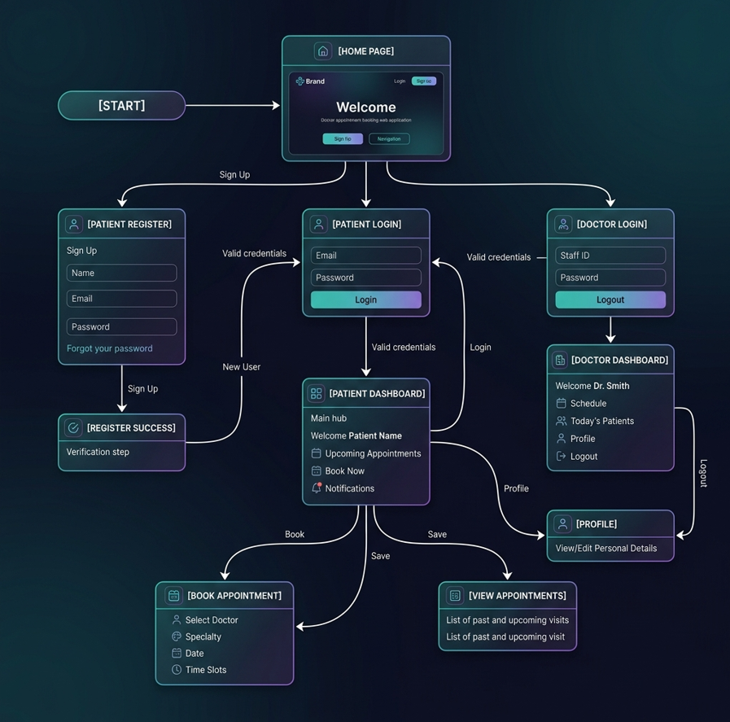
Project Flow Diagram

Slide 7
Objectives with Justification
• Provide online appointment booking – Reduces manual scheduling and saves time.
• Separate Patient and Doctor portals – Ensures efficient role-based management.
• Enable doctor search and filtering – Helps patients find suitable doctors easily.
• Manage appointments effectively – Allows booking, tracking, and cancellation.
• Support doctor availability management – Helps doctors organize their schedules.
• Develop a responsive React-based application – Demonstrates modern Front-End Engineering concepts.

Slide 8

Course Outcomes (COs) Applied in the Project
CO1 – Front-End Engineering & Framework Design
Used React’s component-based architecture and declarative UI.
Implemented reusable components and unidirectional data flow.
CO2 – JavaScript & TypeScript Engineering
Applied ES6+ features such as modules, arrow functions, async/await, promises, and API handling.
Organized the project into modular and maintainable code.
CO3 – React Component Model
Built reusable components for Login, Doctor List, Appointment Booking, Dashboard, and Profile.
Used props, state, hooks, and component composition.
CO4 – State Management & API Integration
Managed appointment data, user sessions, doctor availability, and booking status.
Integrated APIs and handled asynchronous operations using React Hooks.
CO5 – Routing, Forms & Performance
Implemented React Router for navigation.
Built validated login and appointment forms.
Developed a responsive and user-friendly interface.
CO6 – Build Systems & Deployment
Developed the project using React with npm tooling.
Followed modern front-end practices and prepared the application for deployment and scalability.

Slide 9
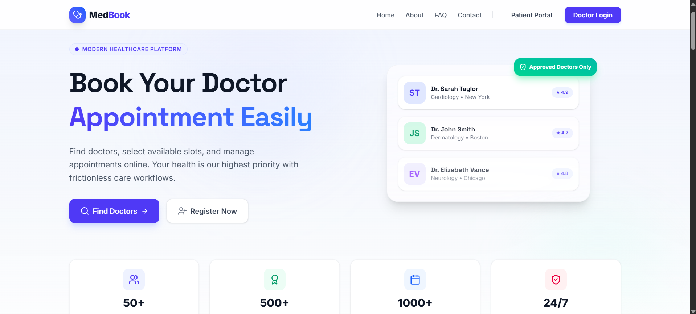
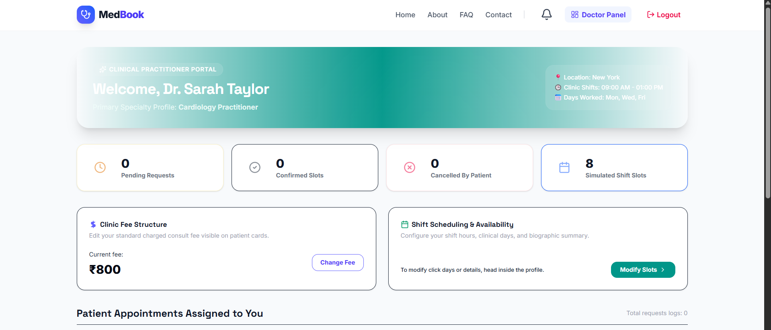
Modules [Frontend web pages]

Slide 10
Expected Outcomes of the Proposed Work
• Provide a simple and efficient online doctor appointment booking platform.
• Enable patients to search doctors and book appointments easily.
• Reduce waiting time and manual appointment scheduling.
• Improve appointment management through separate Patient and Doctor portals.
• Allow doctors to manage availability and appointment requests effectively.
• Provide appointment status tracking and profile management features.
• Deliver a responsive, user-friendly, and accessible healthcare application.
• Demonstrate practical implementation of Front-End Engineering concepts using React.js.

Slide 11
Conclusion and Future Scope
Conclusion
Simplifies doctor appointment booking and management.
Improves communication between patients and doctors.
Provides a user-friendly React-based healthcare platform.
Future Scope
Database integration
Online payments
Email/SMS notifications
Video consultations
AI-based recommendations

Slide 12
References
• React.js Documentation
• React Router Documentation
• MDN Web Docs
• Tailwind CSS Documentation
• Front-End Engineering Course Material
• Online Healthcare Management Resources

Slide 13
Thank you

